Slide 1


Slide 2
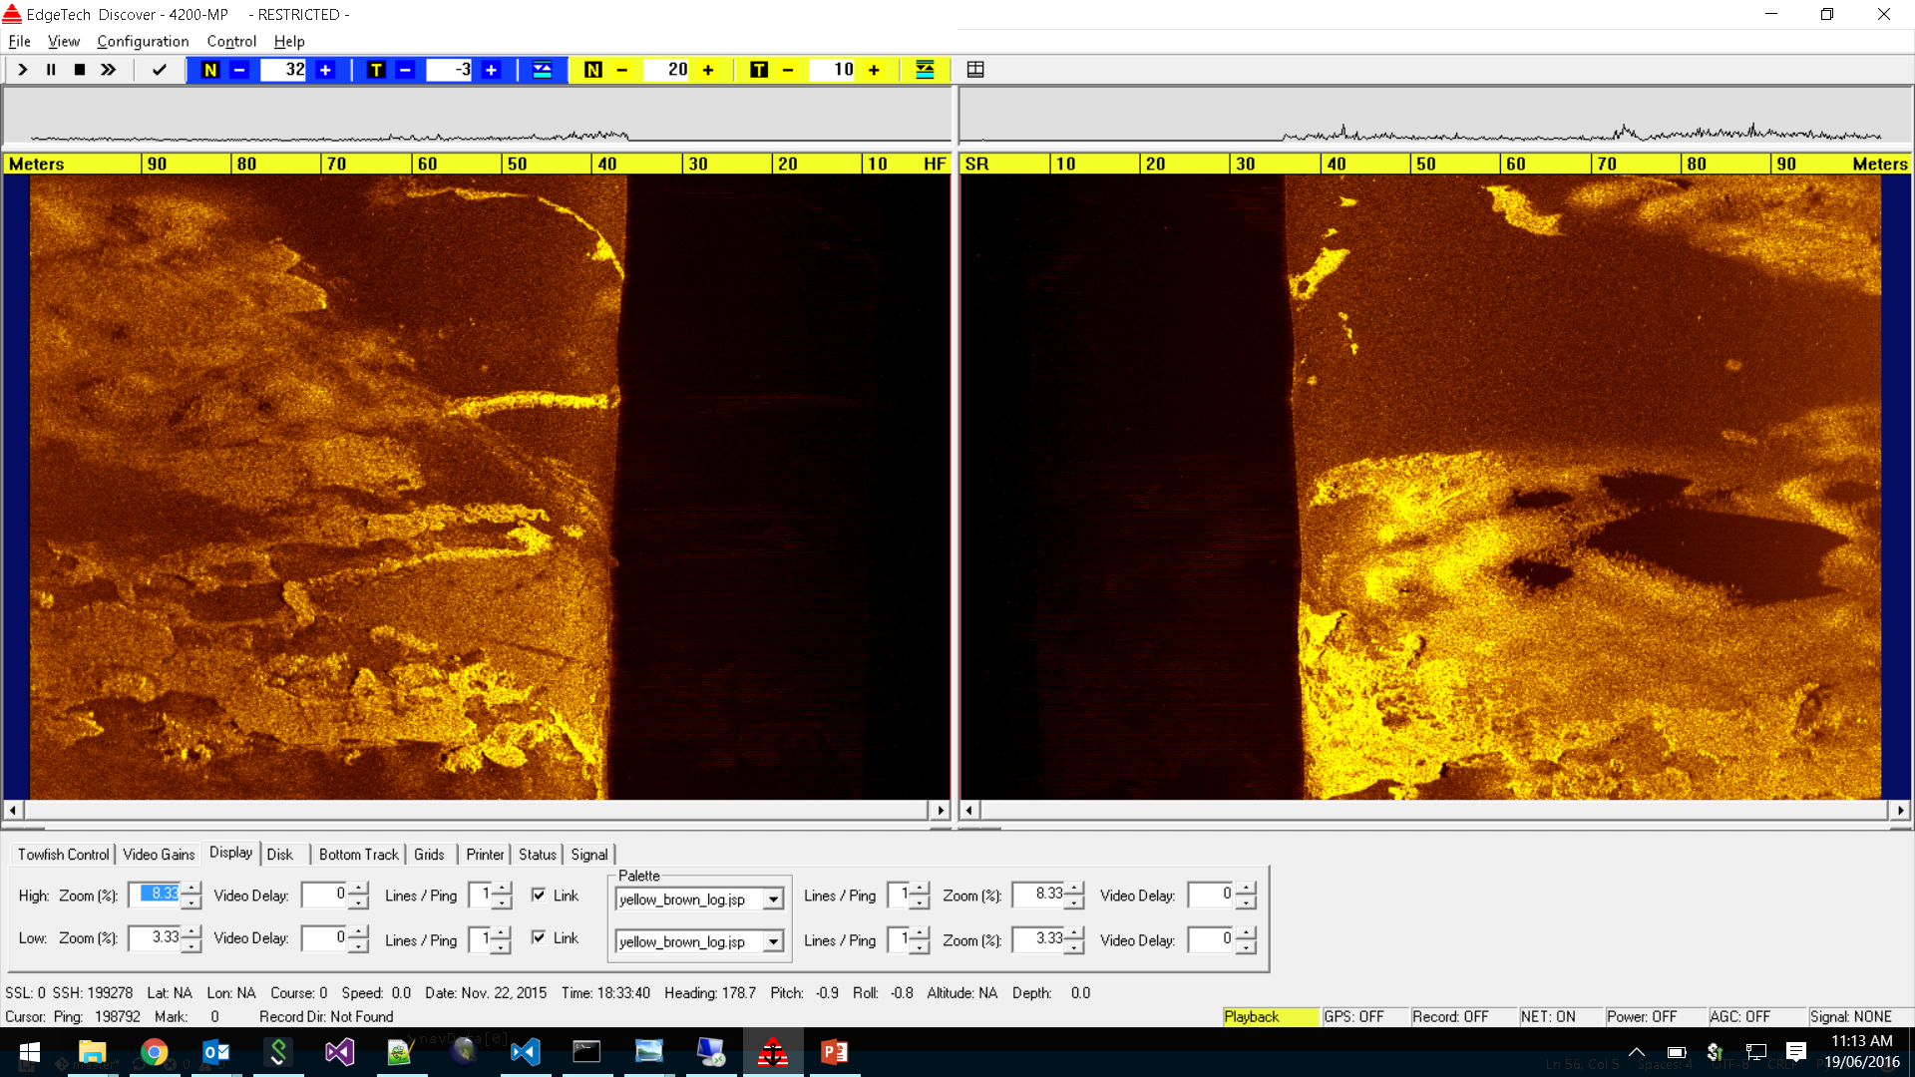
Yellow-Brown Logarithmic scale

Slide 3
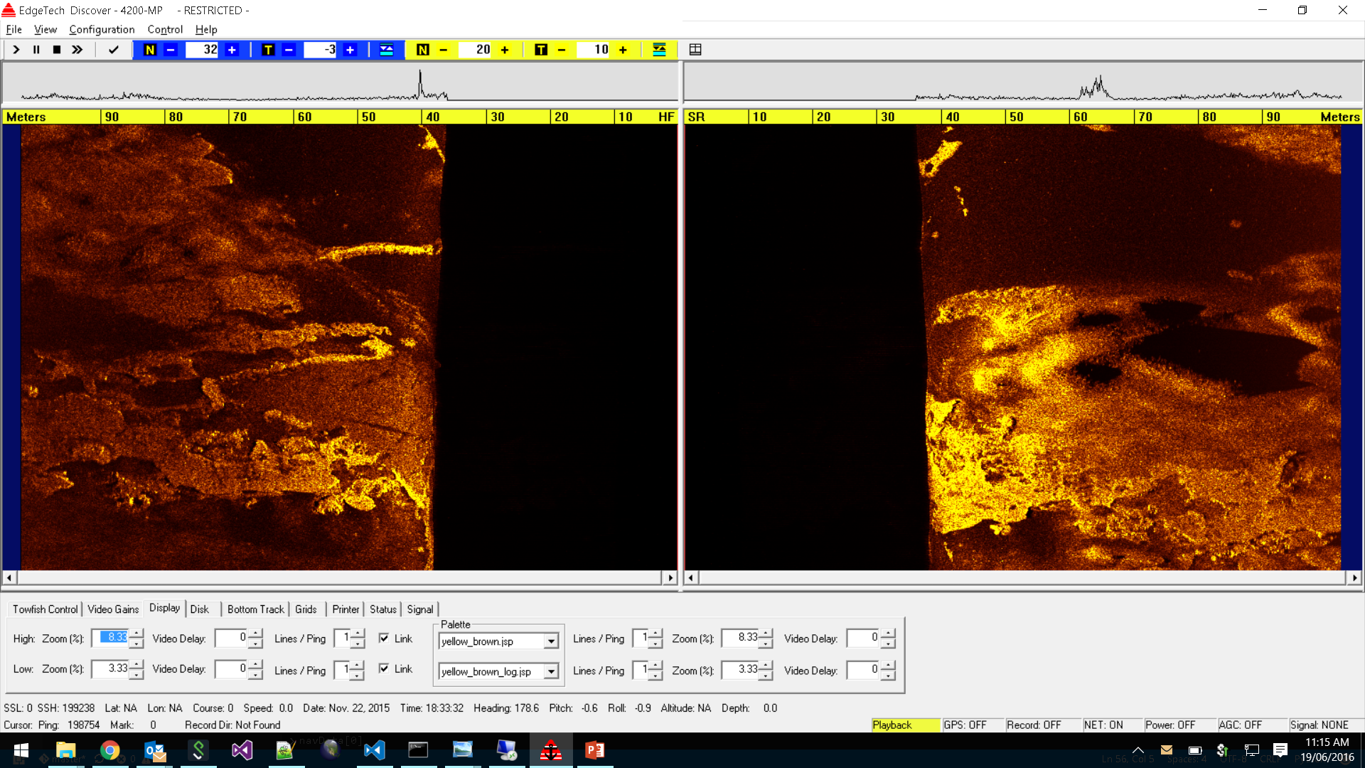
Yellow-Brown scale

Slide 4
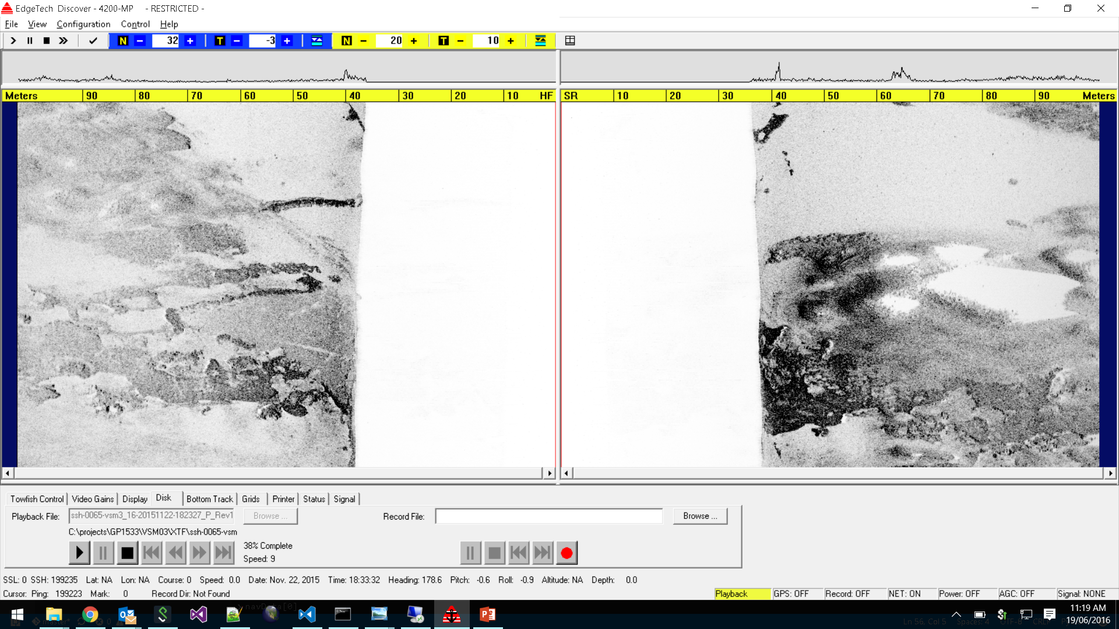
Discover Greyscale

Slide 5
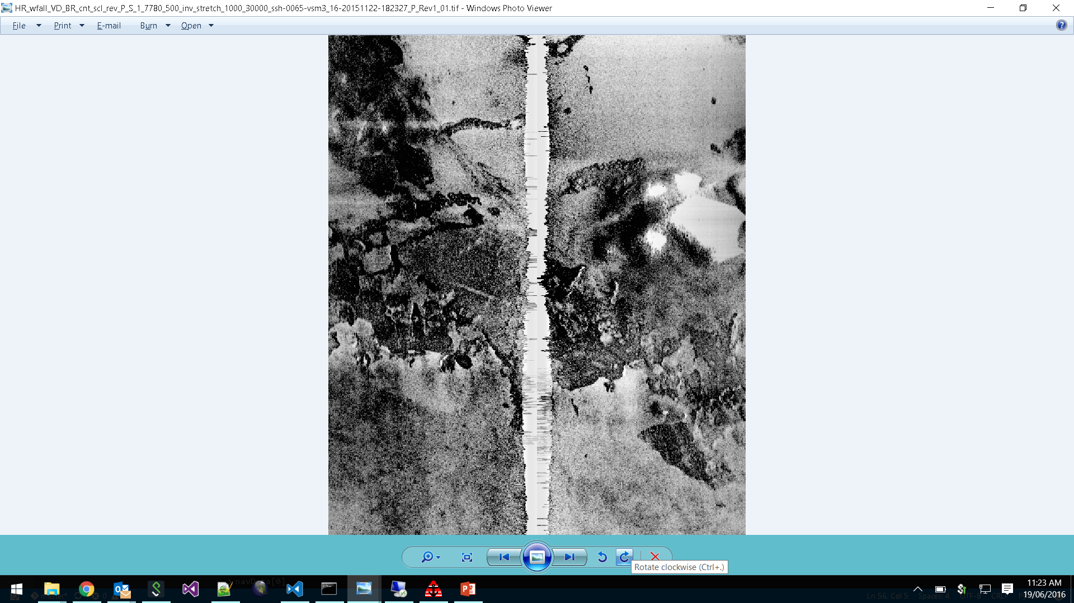
CSIRO Greyscale

Slide 6
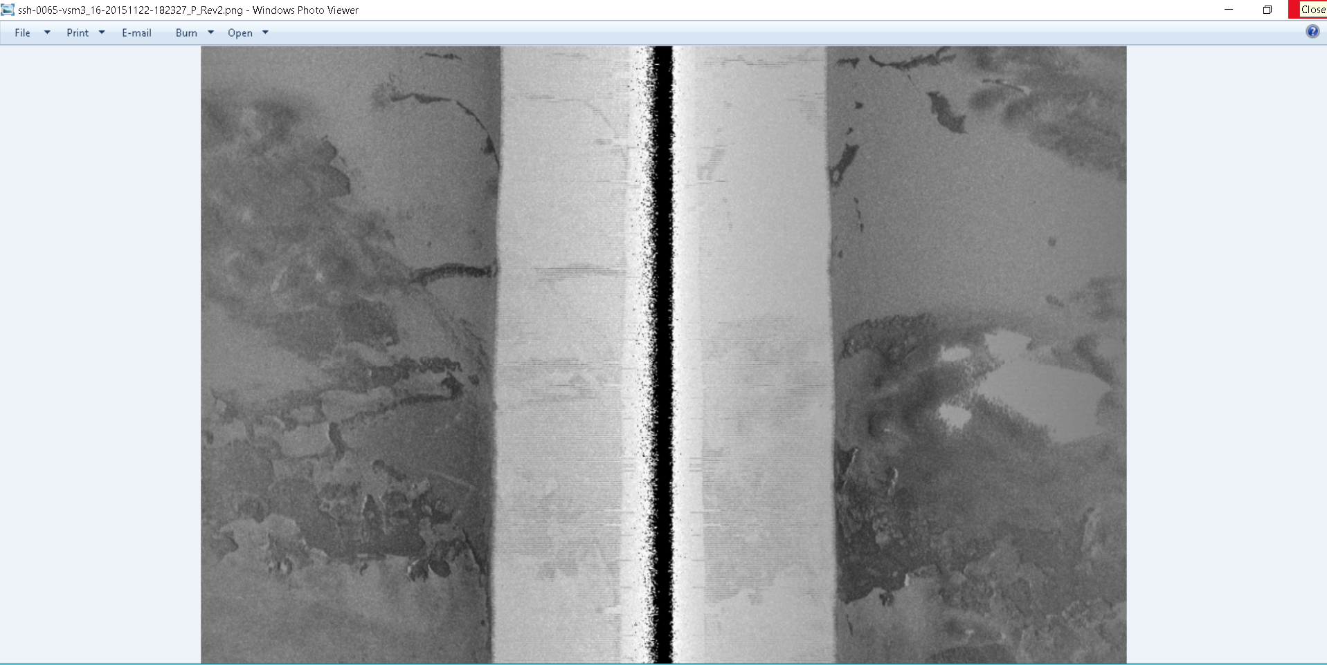
SonarBeamCorrection Gryscale Logarithmic

Slide 7
scale

Slide 8
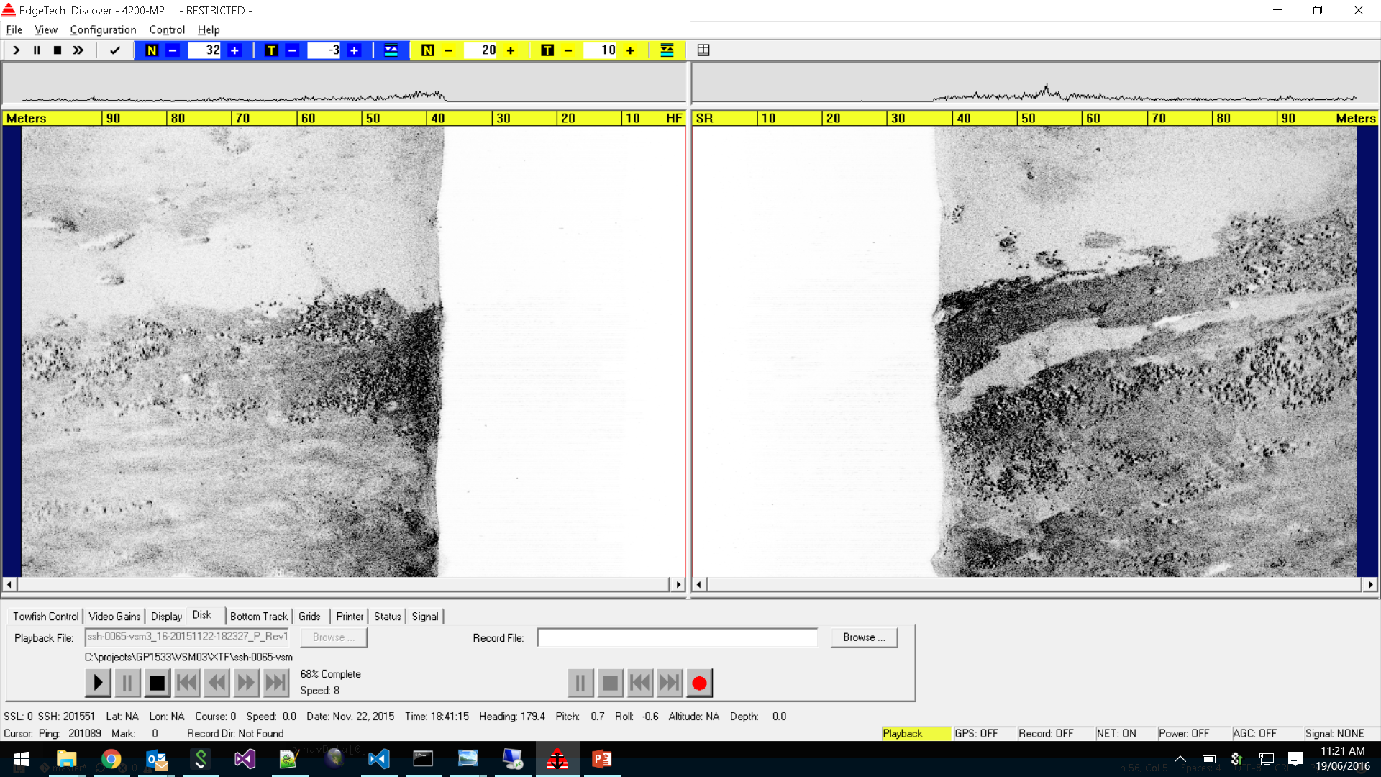
Discover Greyscale

Slide 9
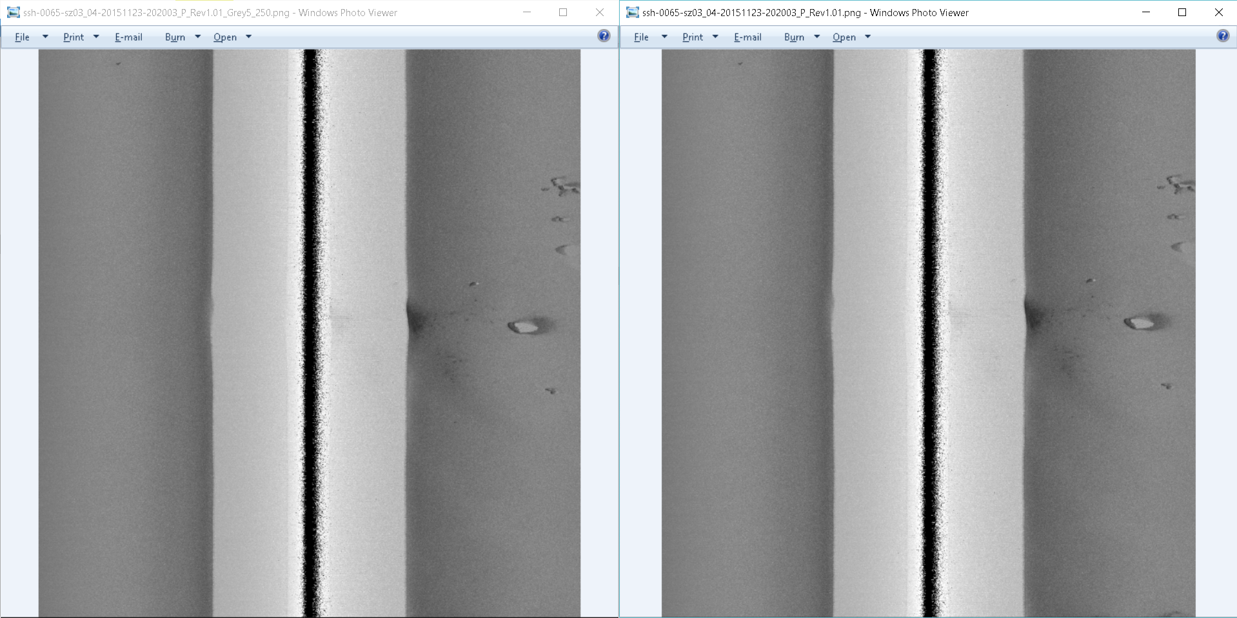
5/250 vs 0/255 grey scale

Slide 10
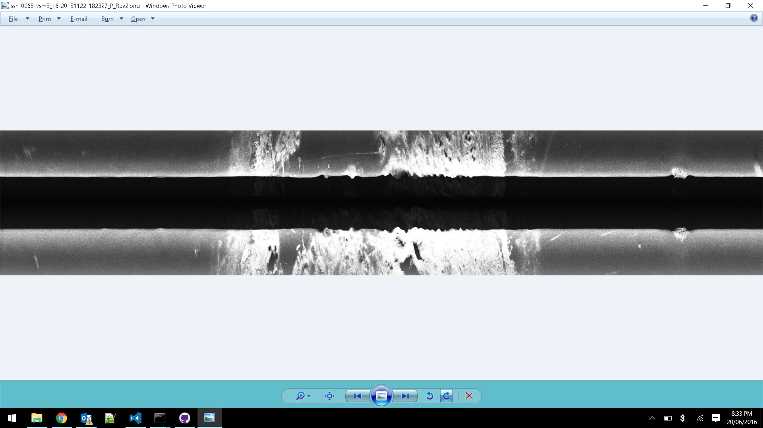
Gray scale linear ramp no clips

Slide 11
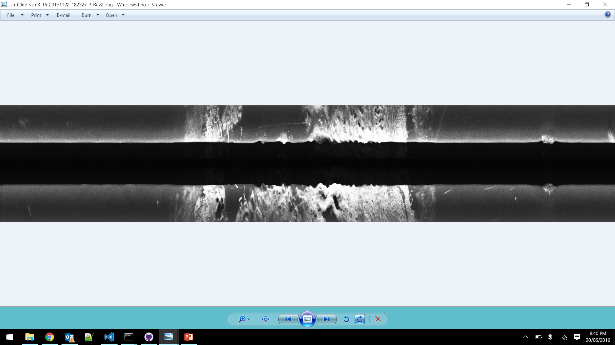
Gray scale linear ramp clip 5%

Slide 12
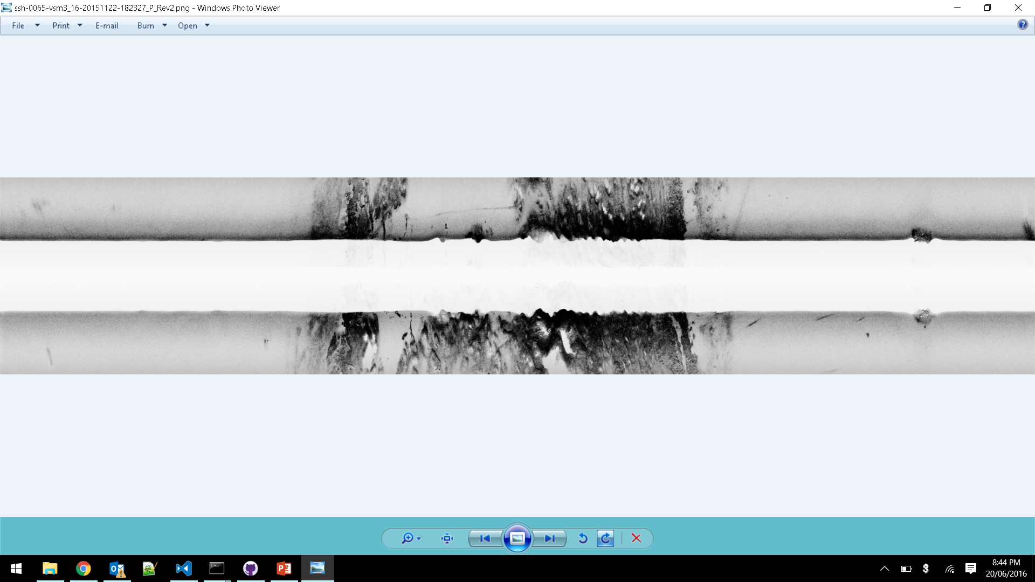
Gray scale linear ramp clips 5% + Inverted

Slide 13
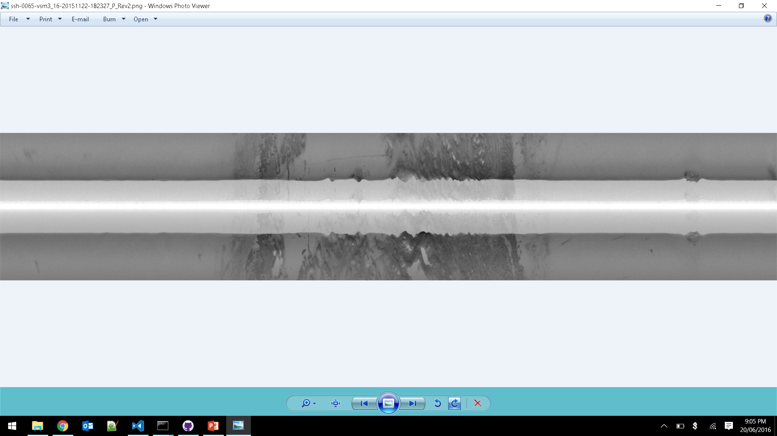
Gray scale logarithmic ramp clips 0% + Inverted

Slide 14
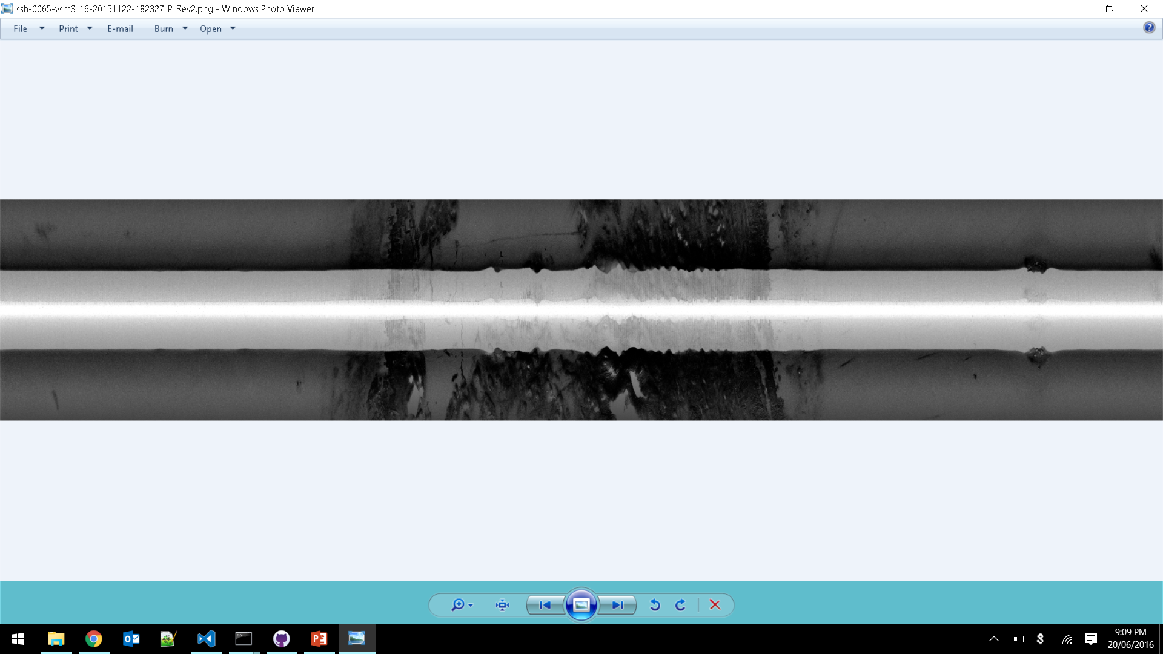
Gray scale logarithmic ramp clips 5% + Inverted

Slide 15
scale

Slide 16
scale

Slide 17
scale

Slide 18
scale

Slide 19
scale

Slide 20
scale

Slide 21
scale

